Slide 1



CYBER ATTACKS IN IOT NETWORKS
PROJECT STUDENTS GUIDE
K. Abhinav, 41110666 Dr. L. Suji Helen, M.E.,Ph.D.,
K. Charan Sai, 41110668
22 July 2024
School of Computing - CSE

Slide 2
AGENDA
Abstract
Objective(s)
Literature Survey
Inferences from Literature Survey
Proposed System
Results and Discussion
Conclusion
References
22 July 2024
School of Computing - CSE

Slide 3
ABSTRACT
The Internet of Things (IoT) is a network of interconnected devices that communicate and exchange data through the internet. This technology has revolutionized various sectors by enabling smart homes, healthcare, industrial automation, and more. However, IoT also introduces significant security challenges. The primary security issues in IoT include data breaches, unauthorized access, and device manipulation. Major attacks on IoT systems, such as the Mirai botnet attack, have demonstrated the vulnerability of these networks to large-scale disruptions. The problems in IoT security system from the lack of standardized security protocols, limited computational resources of IoT devices, and the vast attack surface due to the sheer number of connected devices. This project shows a novel approach to enhancing real-time detection of cyber threats through adaptive machine learning in network traffic analysis. By leveraging machine learning algorithms that can dynamically adjust based on the changing threat landscape, our system is able to effectively detect and classify malicious activities in network traffic in real-time. This adaptive approach allows for more accurate and timely identification of cybersecurity incidents, helping organizations to mitigate potential threats before they can cause significant damage. Our experimental results demonstrate the effectiveness of our approach in improving detection rates and reducing false positives, showcasing the potential of adaptive machine learning in enhancing cybersecurity defenses.
22 July 2024
School of Computing - CSE

Slide 4
OBJECTIVE(S)
The project aims to develop an adaptive machine learning system for real-time detection of cyber threats in IoT networks. This system will accurately identify known attack types, such as DDoS ,R2L,Probe,U2R attacks. By leveraging dynamic machine learning algorithms, the system ensures high accuracy, minimal false positives, and proactive mitigation of potential threats.
22 July 2024
School of Computing - CSE

Slide 5
LITERATURE REVIEW
S.No. | Title | Authors | Journal Details and Year | Year | Observation
1 | Detecting Cyber-Physical Threats in an Autonomous Robotic Vehicle Using Bayesian Networks | A. Bezemskij, G. Loukas, D. Gan, R. J. Anthony | IEEE International Conference on Internet of Things (iThings) and IEEE Green Computing and Communications (GreenCom) and IEEE Cyber, Physical and Social Computing (CPSCom) and IEEE Smart Data (SmartData), Exeter, UK, 2017 iiii | 2017 | Provides a probabilistic approach to threat detection, enhancing predictive accuracy.
2 | Web Data Mining for Cyber Security Threat Detection | T. B. Ghuge, S. Sunil Biradar | International Conference on Inventive Computation Technologies (ICICT), Lalitpur, Nepal, 2024 | 2024 | Enables detection of sophisticated cyber threats using advanced data mining techniques.

Slide 6
LITERATURE REVIEW
S.No. | Title | Authors | Journal Details and Year | Year | Observation
3 | Cyber Threat Intelligence Model: An Evaluation of Taxonomies, Sharing Standards, and Ontologies within Cyber Threat Intelligence | V. Mavroeidis, S. Bromander | European Intelligence and Security Informatics Conference (EISIC), Athens, Greece, 2017 | 2017 | Evaluates different frameworks and standards in cyber threat intelligence.
4 | Automation of Architecture Justification and Parameters Selection of Artificial Neural Networks for Intelligent Detection of Cyber-Physical Threats | A. Rogachev, E. Melikhova | International Russian Automation Conference (RusAutoCon), Sochi, Russian Federation, 2022 | 2022 | Discusses the automation in selecting architecture and parameters for ANNs in threat detection.

Slide 7
LITERATURE REVIEW
S.No. | Title | Authors | Journal Details and Year | Year | Observation
5 | Survey on APT Attack Detection in Industrial Cyber-Physical System | Y. Shi, W. Li, Y. Zhang, X. Deng, D. Yin, S. Deng | International Conference on Electronic Information Technology and Smart Agriculture (ICEITSA), Huaihua, China, 2021 | 2021 | Provides a comprehensive survey of techniques used to detect Advanced Persistent Threats (APT) in industrial systems.
6 | The AI Shield and Red AI Framework: Machine Learning Solutions for Cyber Threat Intelligence (CTI) | Simran, S. Kumar, A. Hans | International Conference on Intelligent Systems for Cybersecurity (ISCS), Gurugram, India, 2024 | 2024 | Discusses a dual-framework approach using AI to enhance cyber threat intelligence and defense mechanisms.

Slide 8
LITERATURE REVIEW
S.No. | Title | Authors | Journal Details and Year | Year | Obseravtion
7 | Examine the Role of Generative AI in Enhancing Threat Intelligence and Cyber Security Measures | V. R. Saddi, S. K. Gopal, A. S. Mohammed, S. Dhanasekaran, M. S. Naruka | 2nd International Conference on Disruptive Technologies (ICDT), Greater Noida, India, | 2024 | Explores how generative AI technologies can be applied to improve threat intelligence and cybersecurity measures..
8 | Mobile Ad Hoc Networks Supporting Adaptive Threat Detection through Intrusion Detection Effective Use of Machine Learning for Cyber Defense | M. Bommy, T. Vivekanandan, Y. Sreeraman, D. Jagadeesan, C. Sunil Kumar, G. Asha | International Conference on Innovative Computing, Intelligent Communication and Smart Electrical Systems (ICSES), Chennai, India, 2023 | 2023 | Focuses on leveraging machine learning for dynamic threat detection in mobile ad hoc networks (MANETs).

Slide 9
LITERATURE REVIEW
S.No. | Title | Authors | Journal Details and Year | Year | Obseravtion
9 | A Model for Cyber Threat Intelligence for Organisations | Z. C. Khan, T. Mkhwanazi, M. Masango | International Conference on Artificial Intelligence, Big Data, Computing and Data Communication Systems (icABCD), Durban, South Africa, 2023 | 2023 | Proposes a structured model for integrating cyber threat intelligence within organizational frameworks.
10 | Cyber Threat Hunting to Detect Unknown Threats in the Enterprise Network | A. H. Nursidiq, C. Lim | IEEE International Conference on Cryptography, Informatics, and Cybersecurity (ICoCICs), Bogor, Indonesia, 2023 | 2023 | Details methods and strategies for proactive cyber threat hunting to identify latent threats in enterprise networks.

Slide 10
INFERENCES FROM LITERATURE SURVEY
1. Limited adaptability: The machine learning algorithms used in network traffic analysis may not be able to dynamically adjust to new and evolving cyber threats, resulting in inadequate protection against emerging risks.
2. Ineffective anomaly detection: The system may struggle to accurately identify and flag unusual or suspicious network behavior, leading to a higher likelihood of cyber attacks going undetected.
3. Insufficient integration: The system may not effectively integrate with other security tools and systems, hindering the overall efficacy of threat detection and response efforts.
Accuracy: reasearch cheyali-60
22 July 2024
School of Computing - CSE

Slide 11
Proposed Systems
To effectively detect and classify the four types of attacks (DOS, Probe, R2L, U2R) with high accuracy, I propose implementing a hybrid model that combines Logistic Regression for its speed and interpretability with ensemble methods and non-linear patterns. Furthermore, feature engineering and real-time traffic aggregation will enhance accuracy by extracting valuable insights from the data.
Logistic Regression is used as the core machine learning model for detecting and classifying the 4 types of attacks (DOS, Probe, R2L, U2R) efficiently. Logistic Regression works by analyzing features like packet counts, TCP flags, and service rates to assign probabilities to each class, identifying the most likely attack type. It is chosen for its speed, lightweight nature, and interpretability, which makes it suitable for real-time IoT environments
To implement the same model using a different algorithm, replace Logistic Regression with an ensemble method such as Random Forest to better handle complex, non-linear patterns. Train the new model on the same dataset, incorporating features like packet counts, service rates, and TCP flags. .

Slide 12
Modules Employed
Dataset Upload:
The dataset is uploaded into the system.
Threshold parameters are defined to set the criteria for detecting anomalies and attacks.
Data Extraction:
Data is extracted from the dataset using SCAPY, a powerful Python library for network traffic analysis.
An algorithm is implemented to differentiate between various types of attacks based on the extracted data.

Slide 13
Modules Employed
Algorithm:
The Logistic Regression model is used for detection.
Chosen because it is:
Simple and efficient.
Interpretable for binary or multi-class classification tasks.
Well-suited for identifying patterns in network traffic.

Slide 14
Modules Employed
Attack Visualization:
Based on the threshold value, detected attacks are identified.
Results are displayed:
In the form of graphs for better visualization.
Highlighting the IP addresses involved in malicious activities
Types
DOS (Denial of Service)
Probe (Scanning for vulnerabilities)
R2L (Remote to Local attacks)
U2R (User to Root escalation)

Slide 15
Modules Completed
Dataset Upload:
The dataset is uploaded into the system.
Threshold parameters are defined to set the criteria for detecting anomalies and attacks.
Data Extraction:
Data is extracted from the dataset using SCAPY, a powerful Python library for network traffic analysis.
An algorithm is implemented to differentiate between various types of attacks based on the extracted data.
11 November 2024
School of Computing - CSE

Slide 16
Modules Completed
Algorithm:
The Logistic Regression model is used for detection.
Chosen because it is:
Simple and efficient.
Interpretable for binary or multi-class classification tasks.
Well-suited for identifying patterns in network traffic.
11 November 2024
School of Computing - CSE

Slide 17
Modules Completed
Attack Visualization:
Based on the threshold value, detected attacks are identified.
Results are displayed:
In the form of graphs for better visualization.
Highlighting the IP addresses involved in malicious activities
Types
DOS (Denial of Service)
Probe (Scanning for vulnerabilities)
R2L (Remote to Local attacks)
U2R (User to Root escalation)

Slide 18
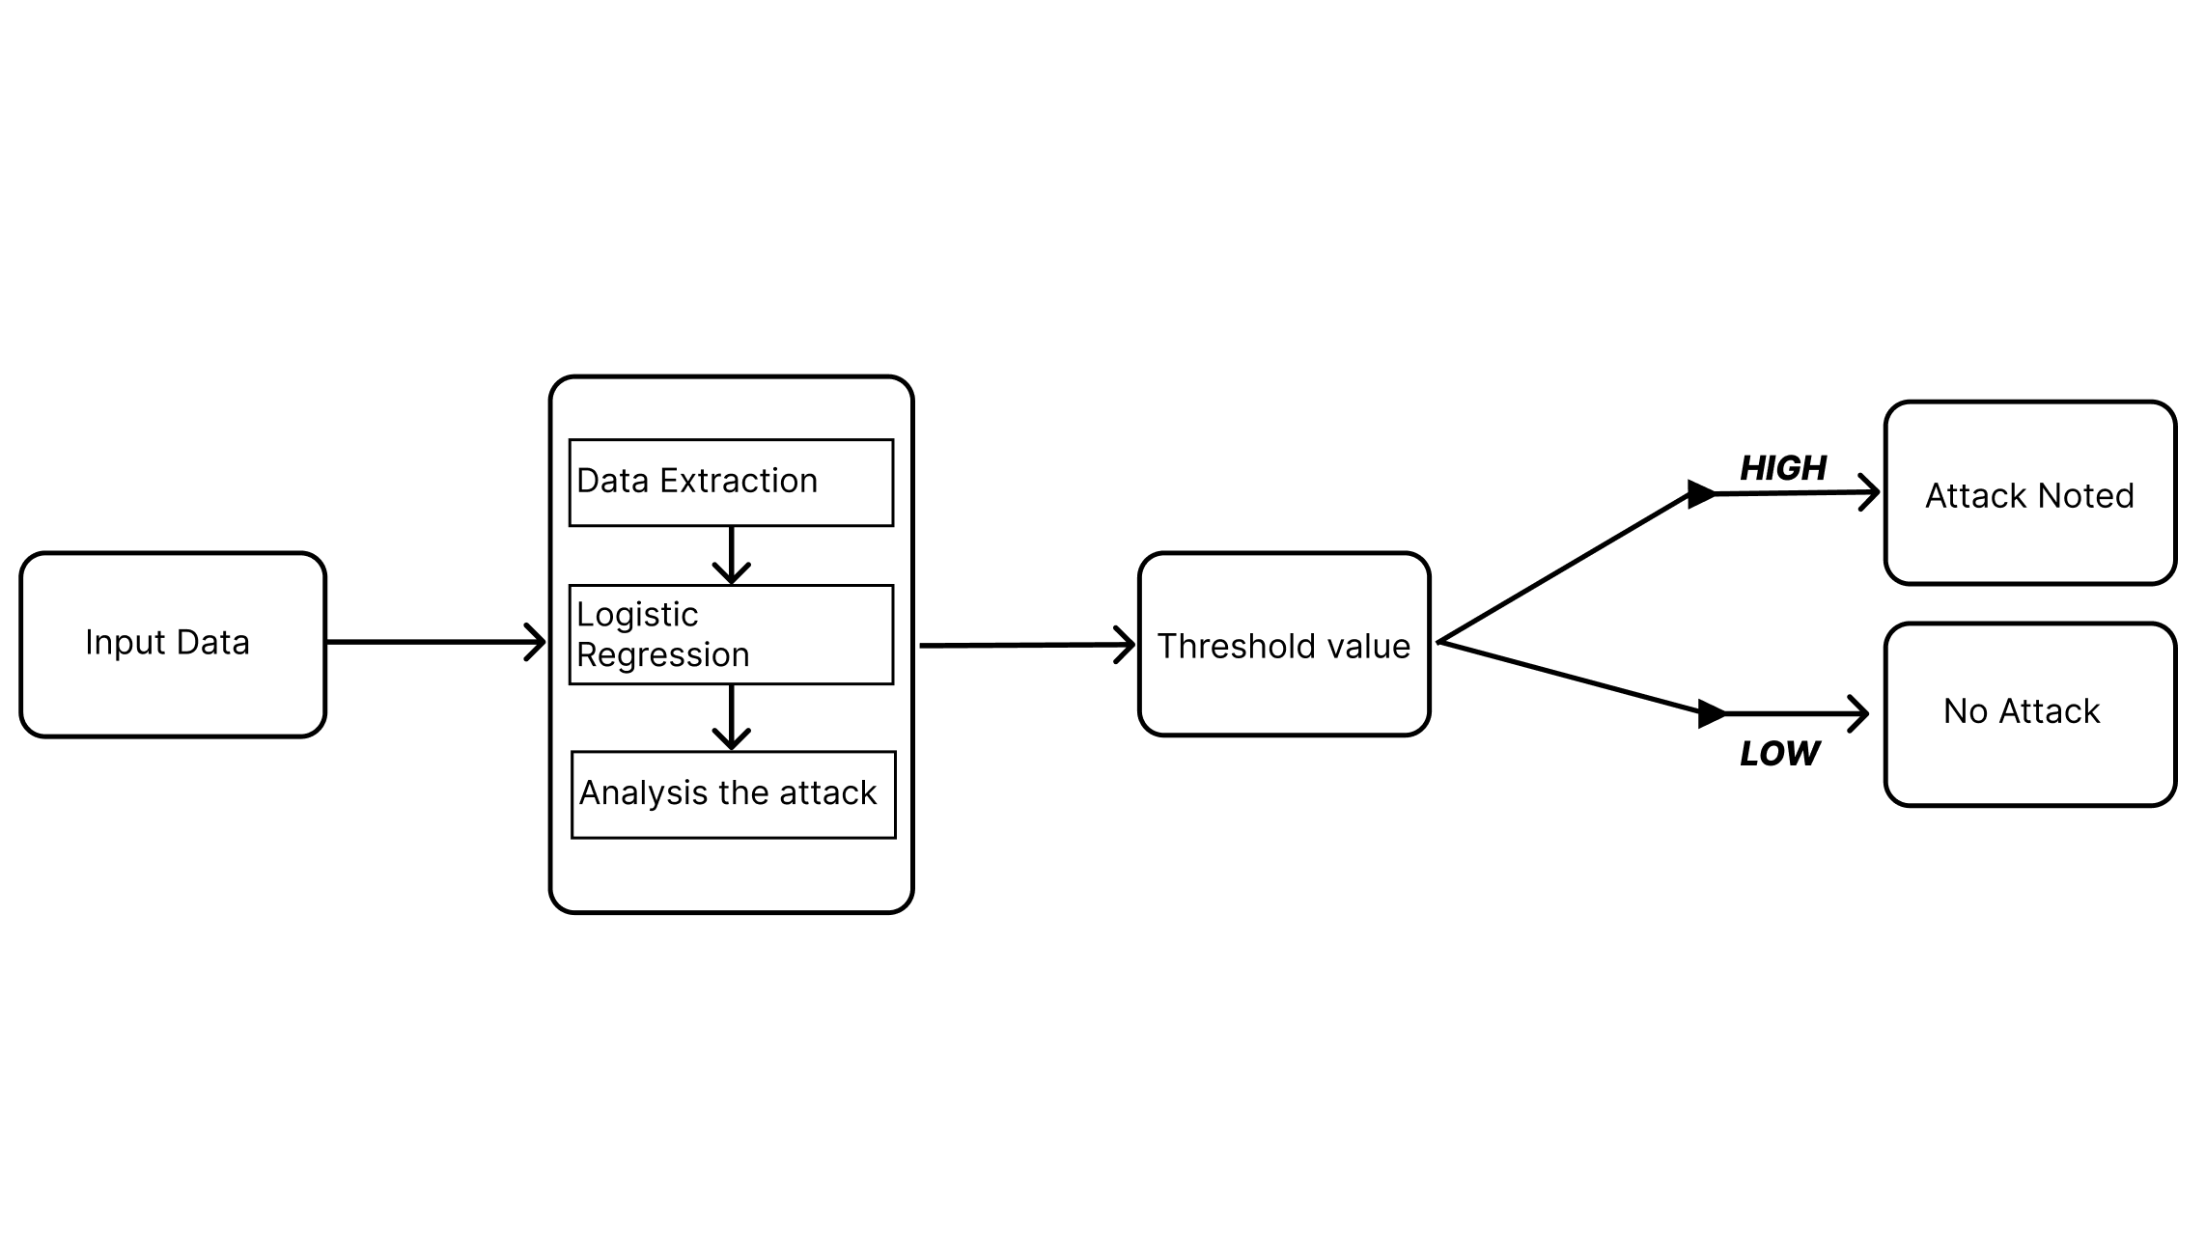
Architecture Diagram
22 July 2024
School of Computing - CSE

Slide 19
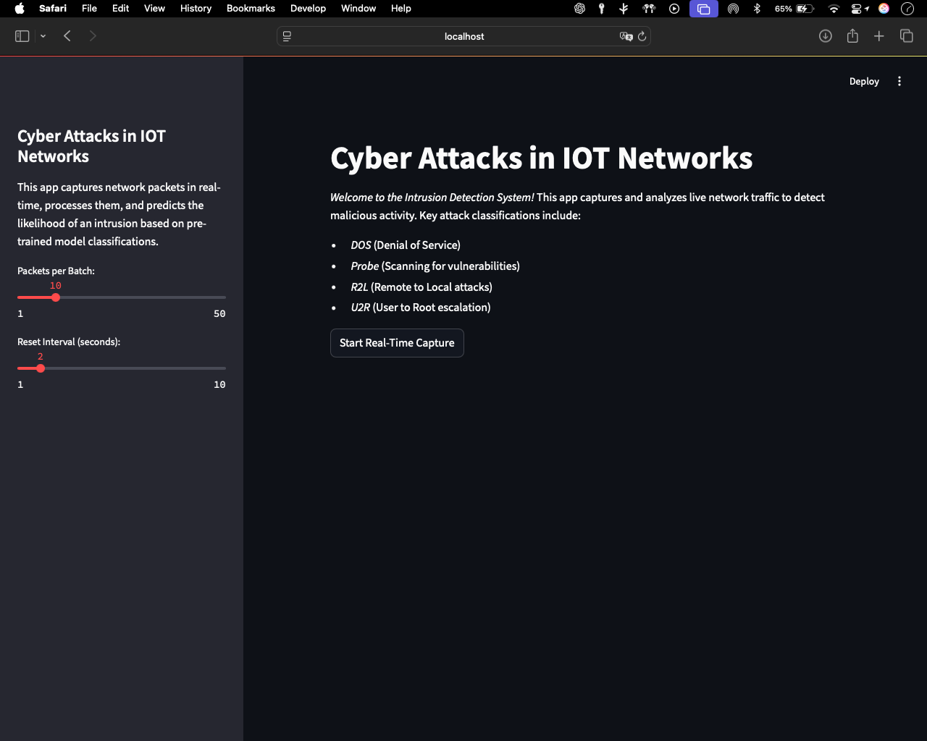
Results and Discussion (1/4)
The first page allows users to interact with the basic user interface.
Users can set the basic threshold value to determine the output and types of attacks.
11 November 2024
School of Computing - CSE

Slide 20
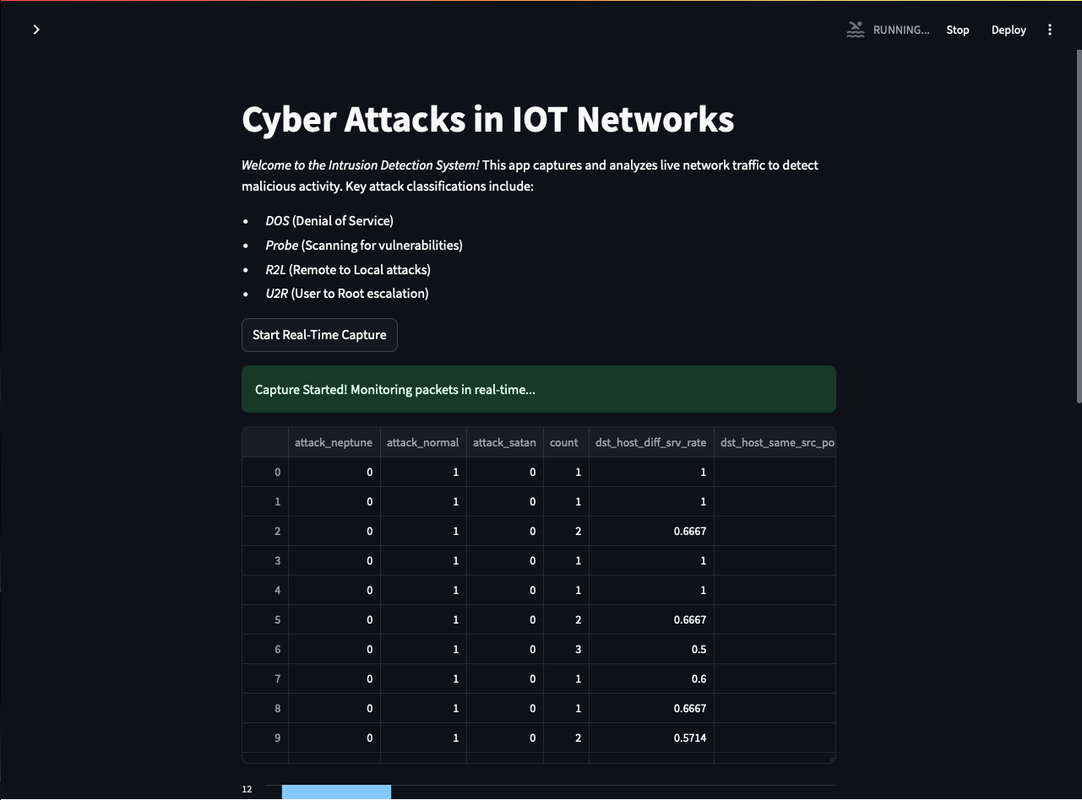
Results and Discussion (2/4)
After clicking the “Start Real-Time Capture” button,
The types of attacks are displayed in a tabular format.
11 November 2024
School of Computing - CSE

Slide 21
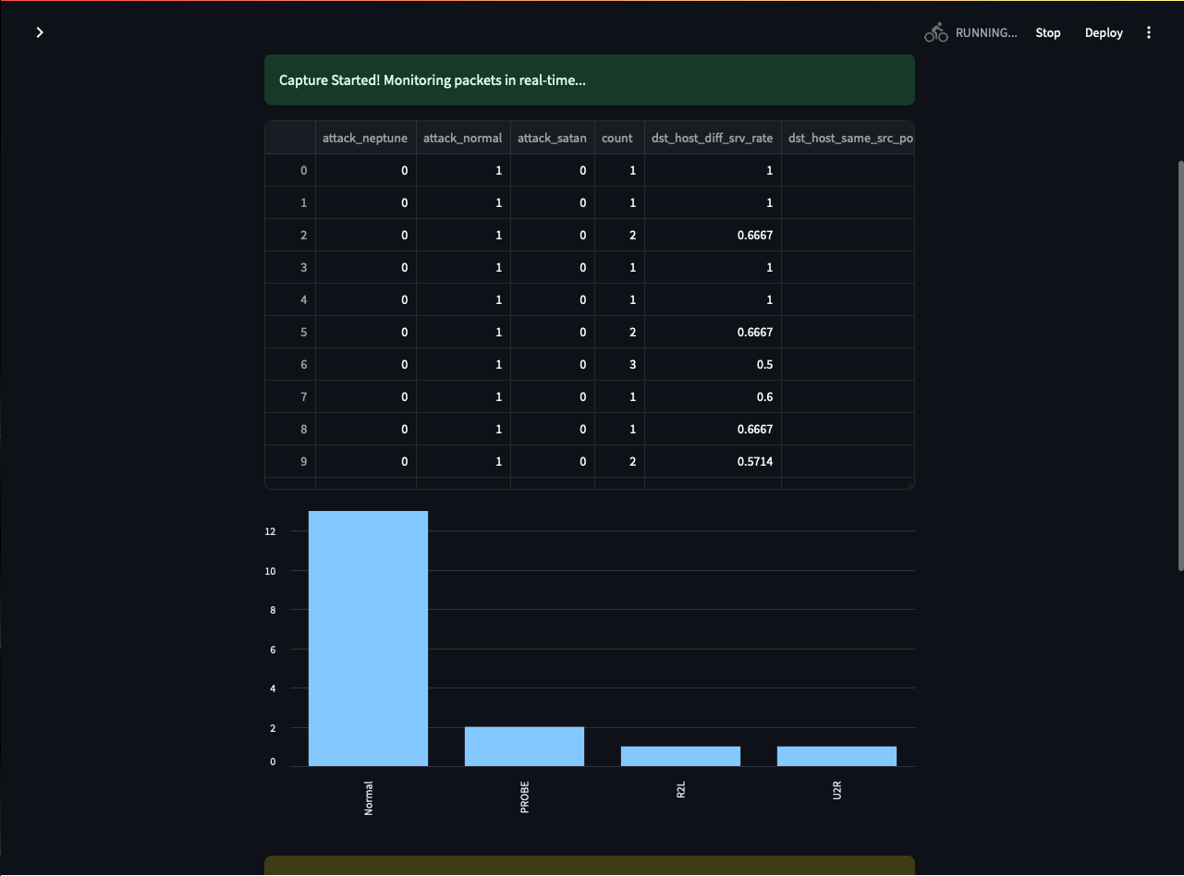
Results and Discussion (3/4)
The bargraph below the table illustrates how different types are being noted.
11 November 2024
School of Computing - CSE

Slide 22
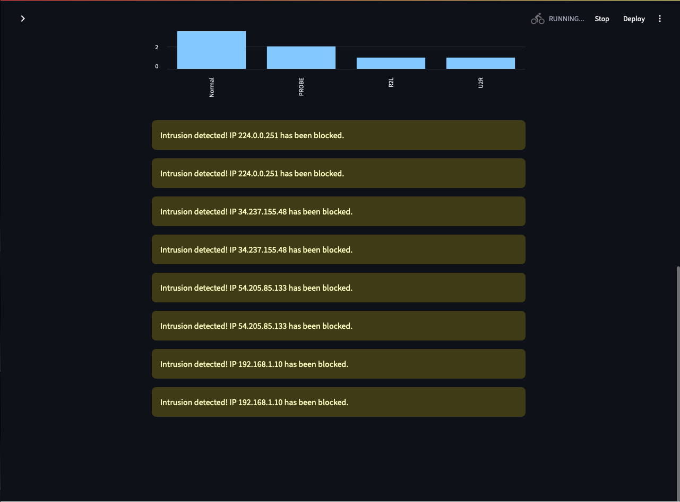
Result and Discussion (4/4)
The attacked IP addresses are being displayed below the graph for better understanding of which address got attacked.
11 November 2024
School of Computing - CSE

Slide 23
CONCLUSION
In conclusion, the use of adaptive machine learning in network traffic analysis has proven to be an effective tool in enhancing real-time detection of cyber threats. By continuously evolving and updating its algorithms based on new data, adaptive machine learning enables organizations to stay one step ahead of cyber attackers. This proactive approach not only improves the accuracy of threat detection but also reduces the response time, minimizing potential damage and loss. By combining adaptive machine learning with network traffic analysis, organizations can significantly improve their cybersecurity posture and better protect their digital assets from evolving cyber threats.
22 July 2024
School of Computing - CSE

Slide 24
REFERENCES
A. Bezemskij, G. Loukas, D. Gan and R. J. Anthony, "Detecting Cyber-Physical Threats in an Autonomous Robotic Vehicle Using Bayesian Networks," 2017 IEEE International Conference on Internet of Things (iThings) and IEEE Green Computing and Communications (GreenCom) and IEEE Cyber, Physical and Social Computing (CPSCom) and IEEE Smart Data (SmartData), Exeter, UK, 2017, pp. 98-103, doi: 10.1109/iThings-GreenCom-CPSCom-SmartData.2017.20.
T. B. Ghuge and S. Sunil Biradar, "Web Data Mining for Cyber Security Threat Detection," 2024 International Conference on Inventive Computation Technologies (ICICT), Lalitpur, Nepal, 2024, pp. 1420-1426, doi: 10.1109/ICICT60155.2024.10544843.
V. Mavroeidis and S. Bromander, "Cyber Threat Intelligence Model: An Evaluation of Taxonomies, Sharing Standards, and Ontologies within Cyber Threat Intelligence," 2017 European Intelligence and Security Informatics Conference (EISIC), Athens, Greece, 2017, pp. 91-98, doi: 10.1109/EISIC.2017.20.
A. Rogachev and E. Melikhova, "Automation of Architecture Justification and Parameters Selection of Artificial Neural Networks for Intelligent Detection of Cyber-Physical Threats," 2022 International Russian Automation Conference (RusAutoCon), Sochi, Russian Federation, 2022, pp. 908-912, doi: 10.1109/RusAutoCon54946.2022.9896311.
Y. Shi, W. Li, Y. Zhang, X. Deng, D. Yin and S. Deng, "Survey on APT Attack Detection in Industrial Cyber-Physical System," 2021 International Conference on Electronic Information Technology and Smart Agriculture (ICEITSA), Huaihua, China, 2021, pp. 296-301, doi: 10.1109/ICEITSA54226.2021.00064.
22 July 2024
School of Computing - CSE

Slide 25
REFERENCES
Simran, S. Kumar and A. Hans, "The AI Shield and Red AI Framework: Machine Learning Solutions for Cyber Threat Intelligence(CTI)," 2024 International Conference on Intelligent Systems for Cybersecurity (ISCS), Gurugram, India, 2024, pp. 1-6, doi: 10.1109/ISCS61804.2024.10581195.
V. R. Saddi, S. K. Gopal, A. S. Mohammed, S. Dhanasekaran and M. S. Naruka, "Examine the Role of Generative AI in Enhancing Threat Intelligence and Cyber Security Measures," 2024 2nd International Conference on Disruptive Technologies (ICDT), Greater Noida, India, 2024, pp. 537-542, doi: 10.1109/ICDT61202.2024.10489766.
M. Bommy, T. Vivekanandan, Y. Sreeraman, D. Jagadeesan, C. Sunil Kumar and G. Asha, "Mobile Ad Hoc Networks Supporting Adaptive Threat Detection through Intrusion Detection Effective Use of Machine Learning for Cyber Defense," 2023 International Conference on Innovative Computing, Intelligent Communication and Smart Electrical Systems (ICSES), Chennai, India, 2023, pp. 1-5, doi: 10.1109/ICSES60034.2023.10465320.
Z. C. Khan, T. Mkhwanazi and M. Masango, "A Model for Cyber Threat Intelligence for Organisations," 2023 International Conference on Artificial Intelligence, Big Data, Computing and Data Communication Systems (icABCD), Durban, South Africa, 2023, pp. 1-7, doi: 10.1109/icABCD59051.2023.10220503.
A. H. Nursidiq and C. Lim, "Cyber Threat Hunting to Detect Unknown Threats in the Enterprise Network," 2023 IEEE International Conference on Cryptography, Informatics, and Cybersecurity (ICoCICs), Bogor, Indonesia, 2023, pp. 303-308, doi: 10.1109/ICoCICs58778.2023.10277438.
22 July 2024
School of Computing - CSE

Slide 26
THANK YOU
We thank God, Our Department, Guide, Panel Members, Supportive Professors and all Technical and non Technical staff who helped us in our Project.
22 July 2024
School of Computing - CSE

